Slide 1


WIPRO CAPSTONE
PROJECT
C-2 GROUP-1
TITLE : SHOP-FOR-HOME
PRESENTED BY:
RAGAM SANTHOSHI
PAYAL SHRIKANT PAWAR
JUHI FATHEEN
BINDU K O
BAIRI ROHITH REDDY

Slide 2
CONTENTS
Introduction
Technologies and Tools used
Project Objective
User Functionalities
Admin Functionalities
Frontend Content
Backend Content
Conclusion

Slide 3
INTRODUCTION
Shop For Home is a form of electronic commerce which allows consumers to directly buy goods or services from a seller over the Internet using a web browser or a mobile app.
The main purpose for developing this project in Angular and Java Spring Boot is to manage all the details about items, item category, company, order, sales etc.
There are two categories of user available in this project. First one is for the customers who wish to buy the articles. And another is for the store owners who maintain and updates the information regarding the articles and about the customers.
Here the customers can browse the catalog and select products of interest. The selected items may be collected in a shopping cart. At checkout time, the items in the shopping cart will be presented as an order.

Slide 4
TECHNOLOGIES AND TOOLS USED
TECHNOLOGIES:
Front-End: HTML, CSS, JAVASCRIPT, BOOTSTRAP, ANGULAR 8
Back-End: Eclipse
TOOLS:
Front-End: Visual Studio Code
Back-End: Eclipse, MySQL Workbench 8.0CE
Browser: Google Chrome For Development

Slide 5
PROJECT OBJECTIVE
The objective of the project is to make an application in android platform to purchase items in an existing shop. In order to build such an application complete web support need to be provided.
The central concept of the application is to allow the customer to shop virtually using the Internet and allow customers to buy the items and articles of their desire from the store.
A complete and efficient web application which can provide the online shopping experience is the basic objective of the project.

Slide 6
USER FUNCTIONALITIES
As a user I should be able to login, Logout and Register into the application.
As a user I should be able to see the products in different categories.
As a user I should be able to sort the products.
As a user I should be able to add the products into the shopping cart.
As a user I should be able to increase or decrease the quantity added in the cart.
As a user I should be able to add “n” number of products in the cart.
As a user I should be able to get the Wishlist option where I can add those products which I want but don’t want to order now.
As a user I should get different discount coupon.

Slide 7
ADMIN FUNCTIONALITIES
As an Admin I should be able to login, Logout and Register into the application.
As an Admin I should be able to perform CRUD on Users.
As an Admin I should be able to Perform CRUD on the products.
As an Admin I should be able to get bulk upload option to upload a csv for products details
As an Admin I should be able to get the stocks.
As an Admin I should be able to mail if any stock is less than 10.
As an Admin I should be able to get the sales report of a specific duration.
As an Admin I should be able to set of users

Slide 8
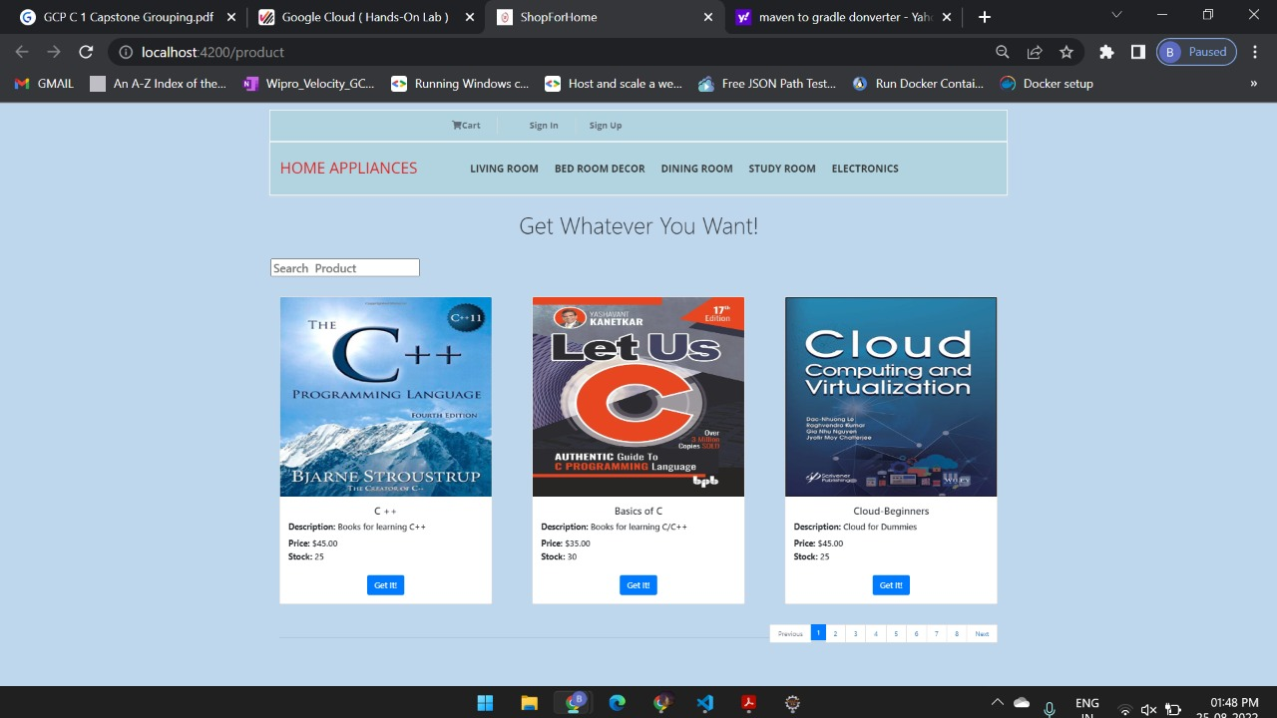
HOME PAGE

Slide 9
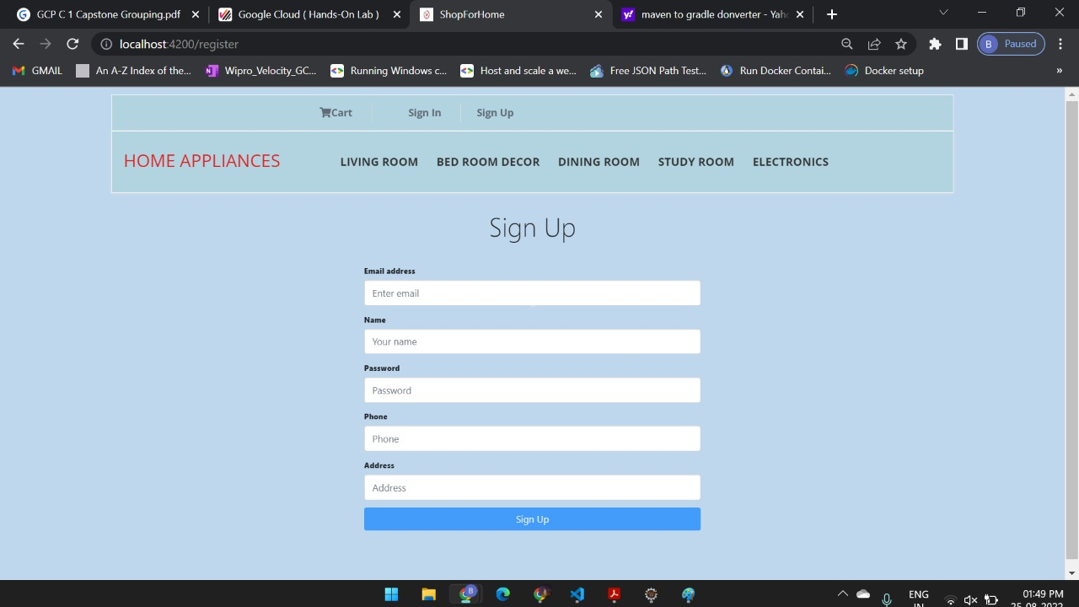
SIGN-UP PAGE

Slide 10
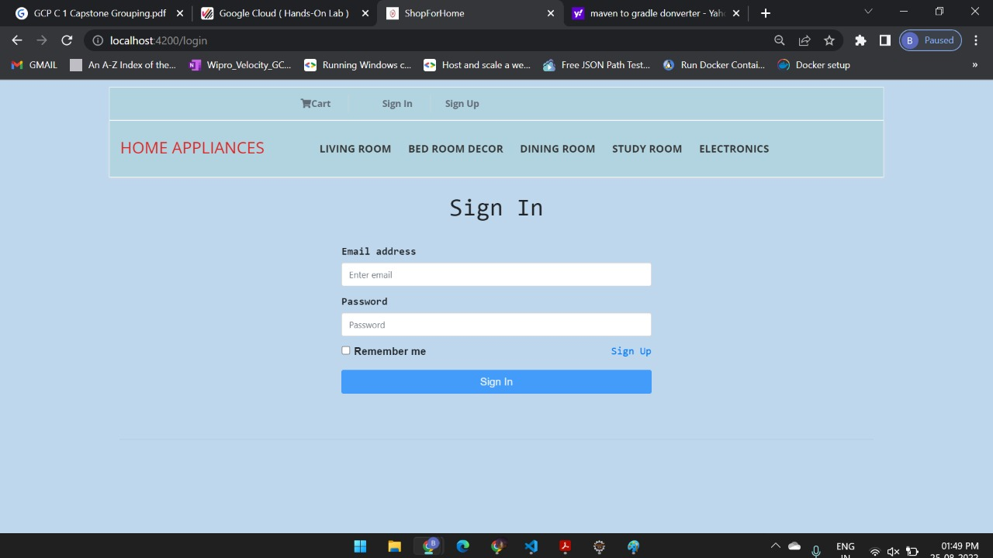
SIGN-IN PAGE

Slide 11
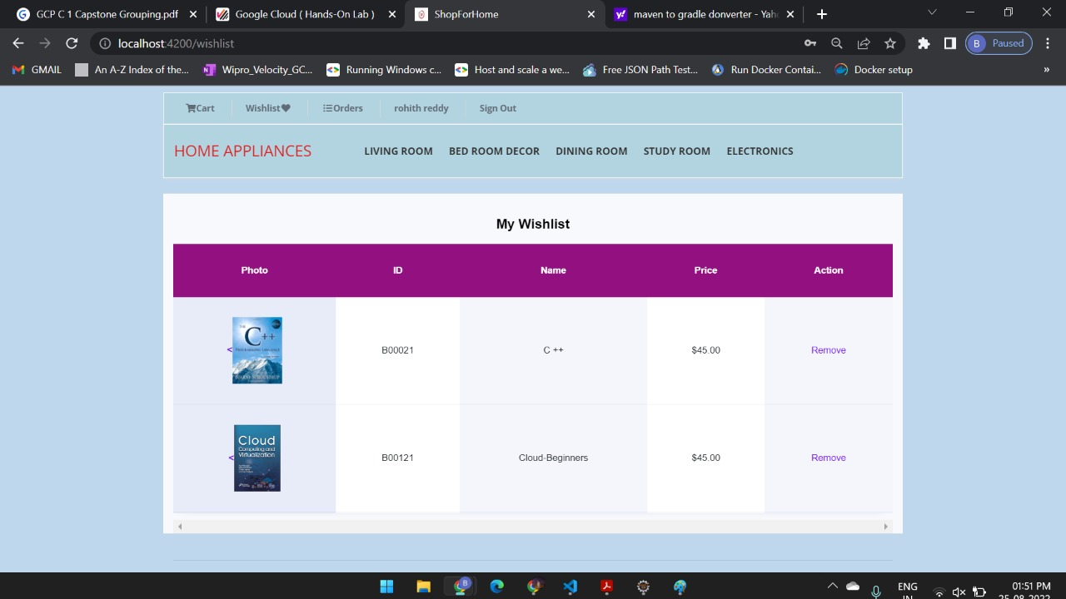
MY WISHLIST

Slide 12
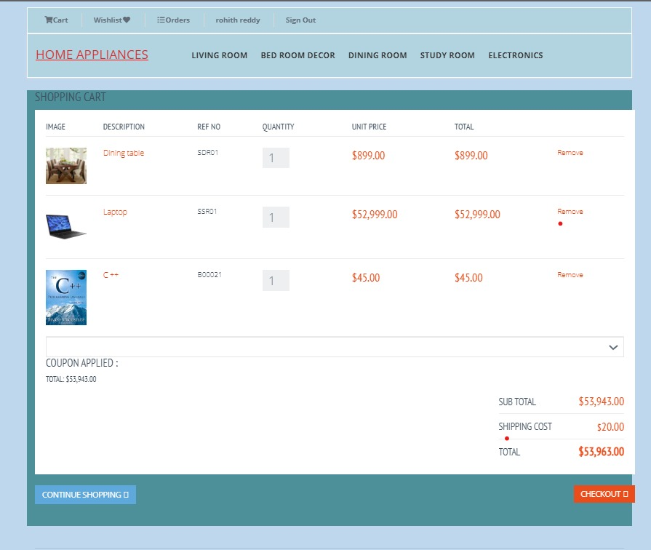
SHOPPING CART

Slide 13
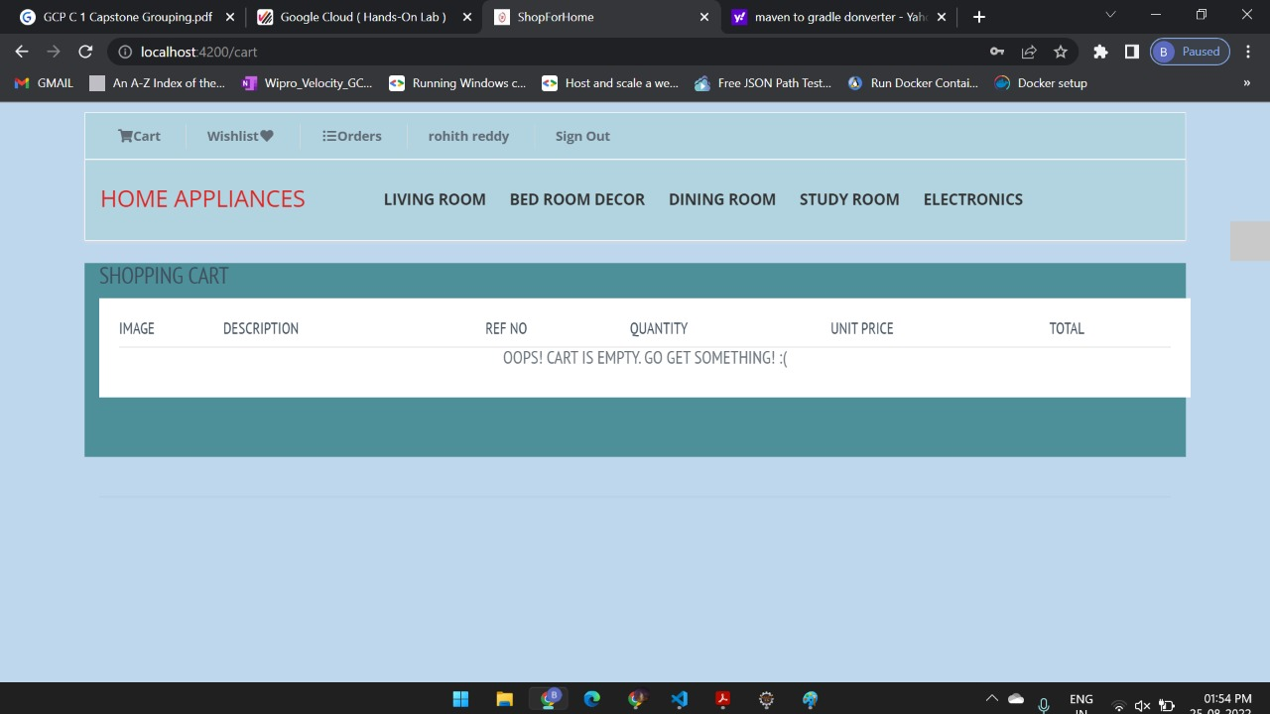
EMPTY CART

Slide 14
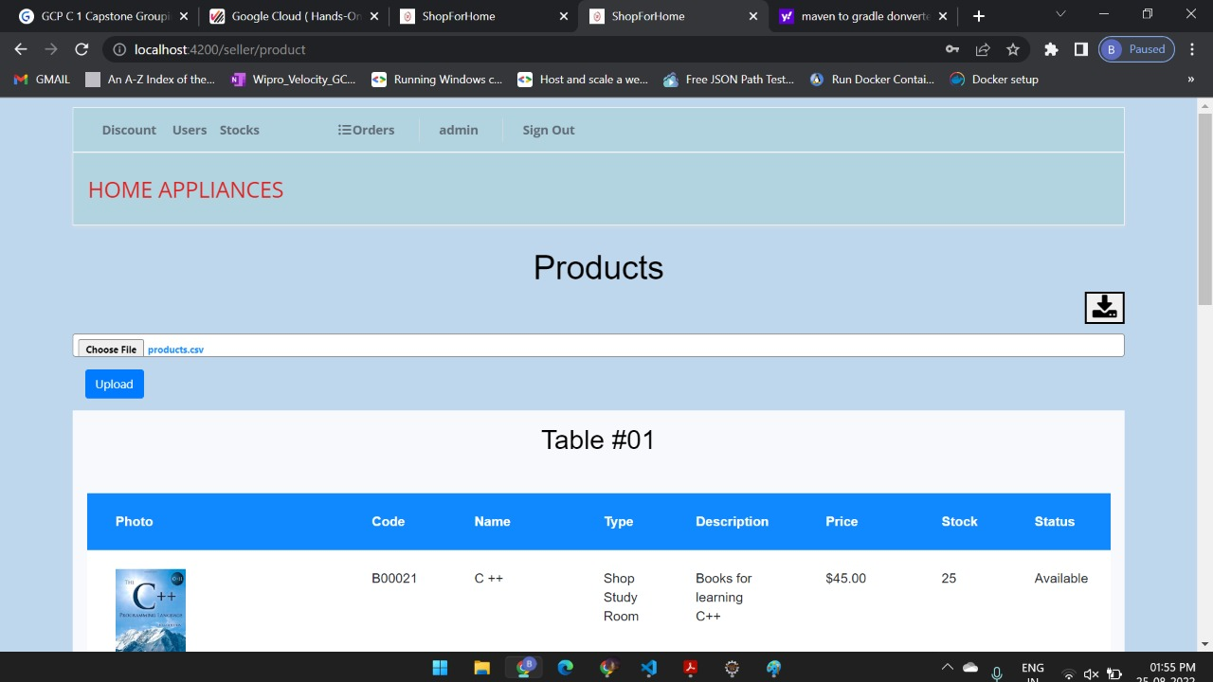
BULK UPLOAD

Slide 15
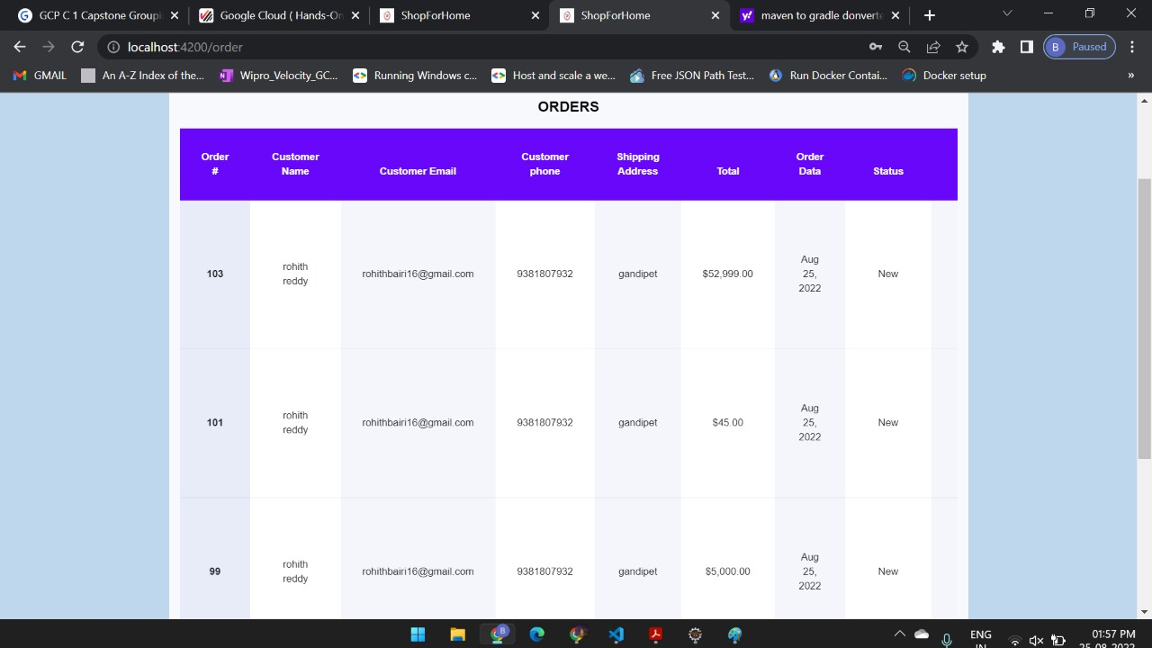
MY ORDERS

Slide 16
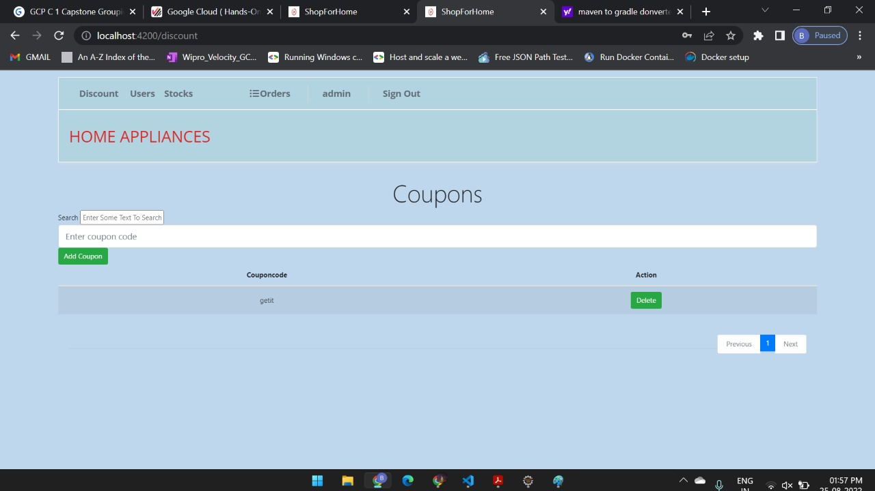
COUPONS

Slide 17
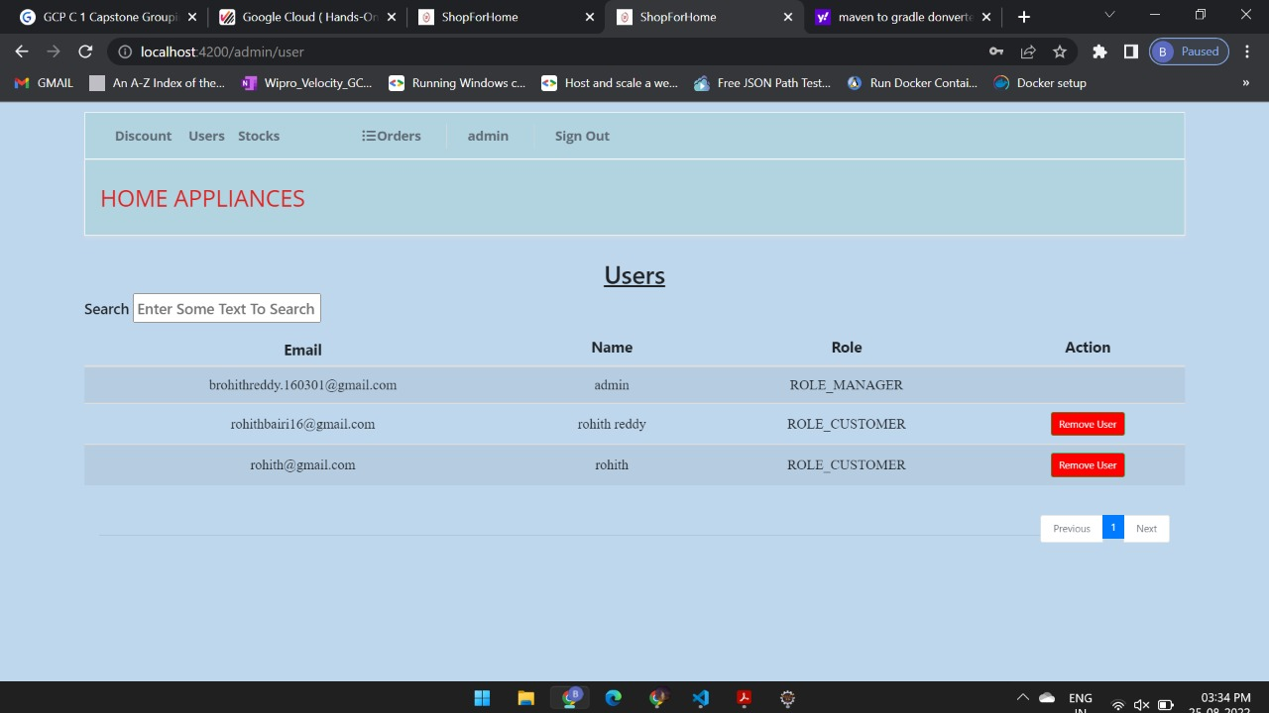
ADMIN VIEW

Slide 18
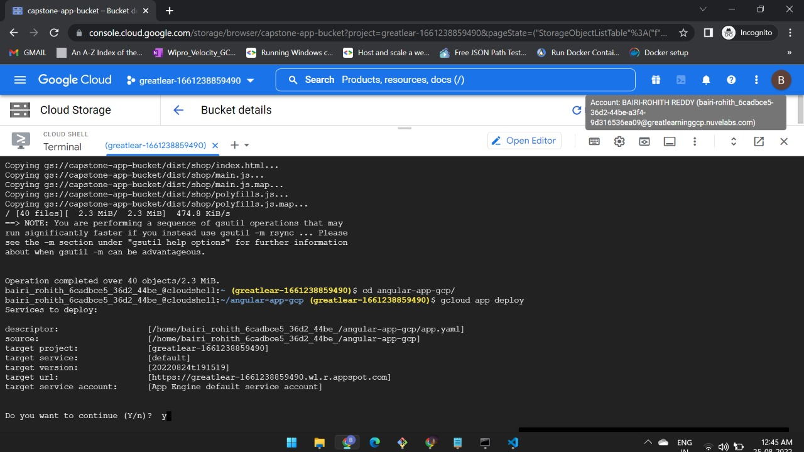
DEPLOYMENT INTO GCP

Slide 19
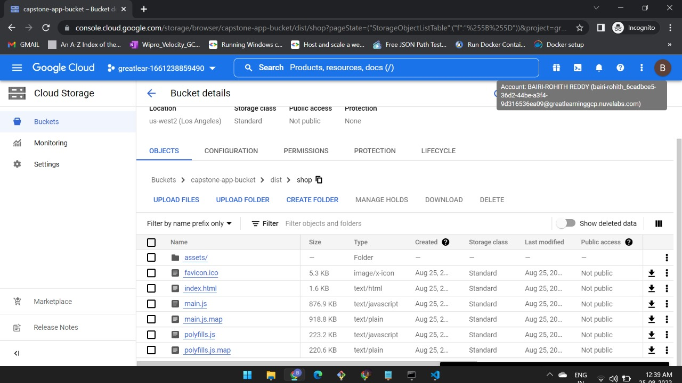

Slide 20
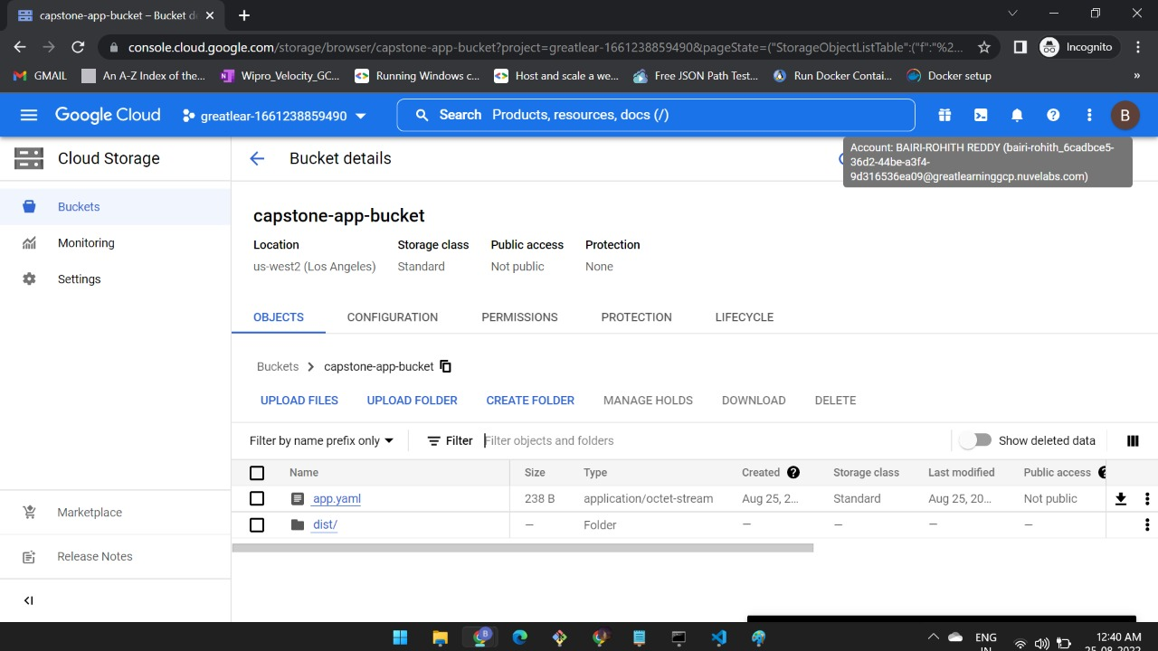

Slide 21
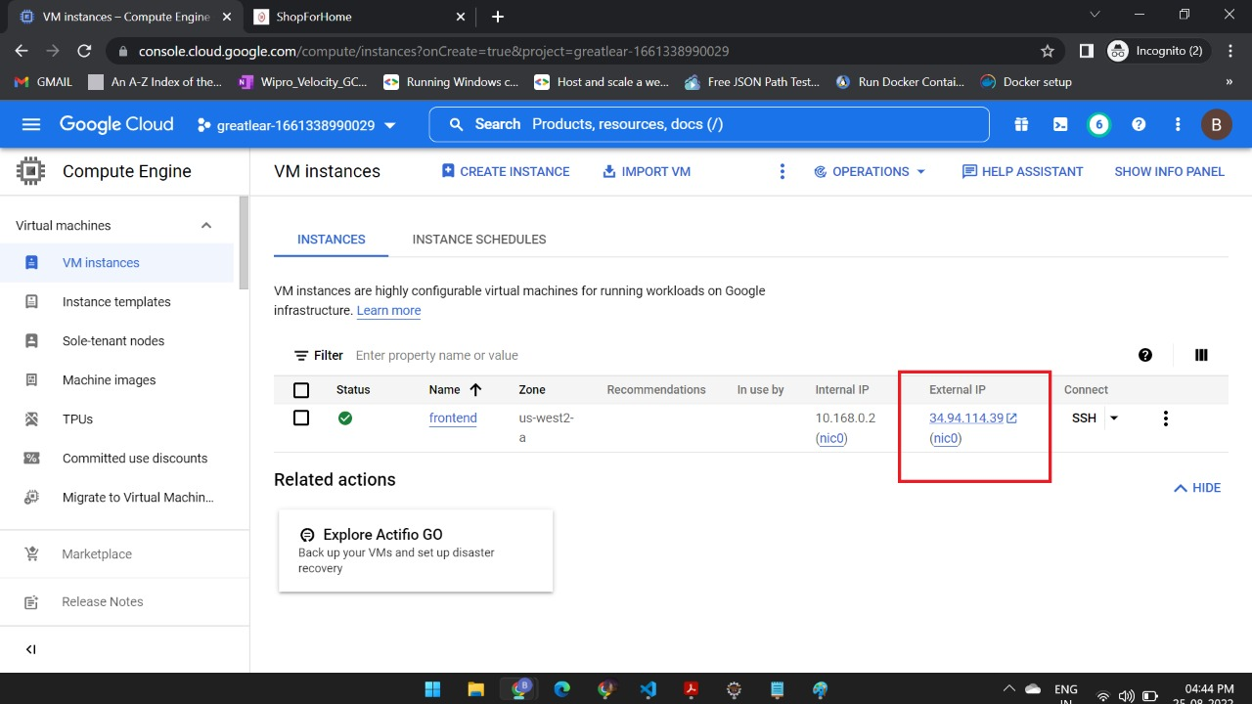

Slide 22
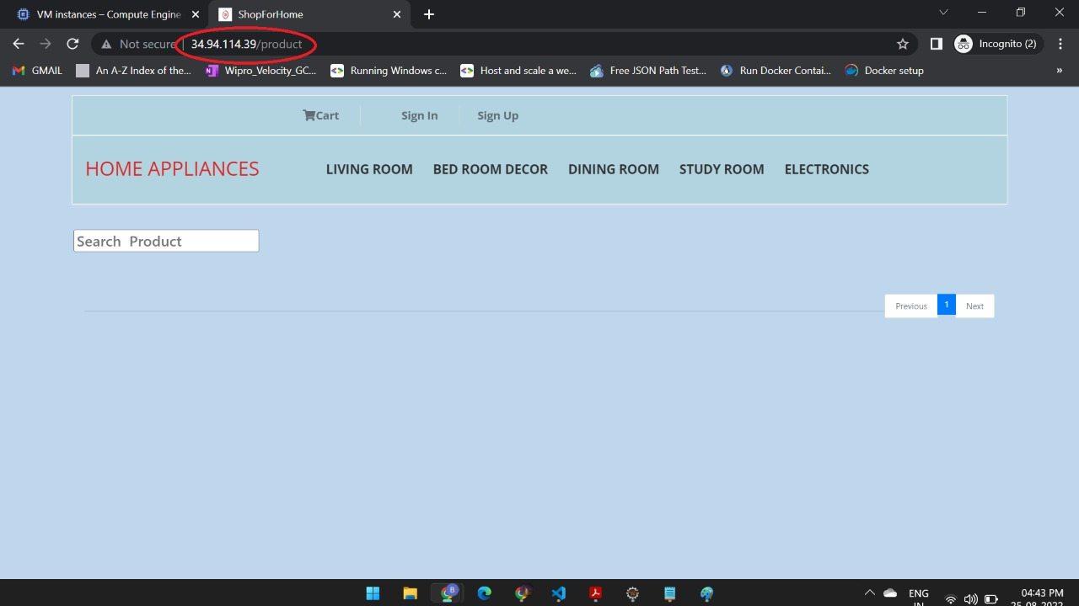

Slide 23
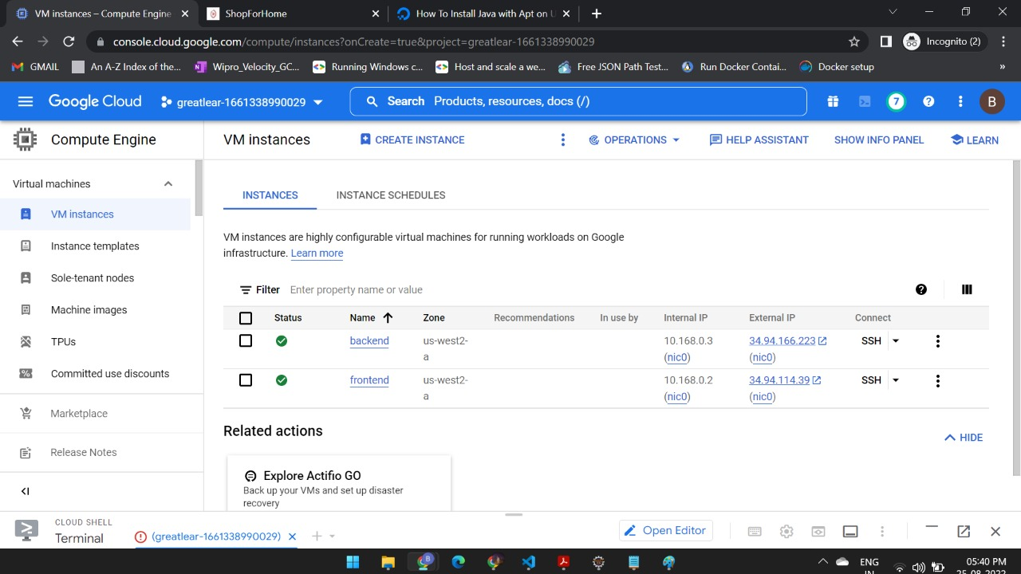

Slide 24
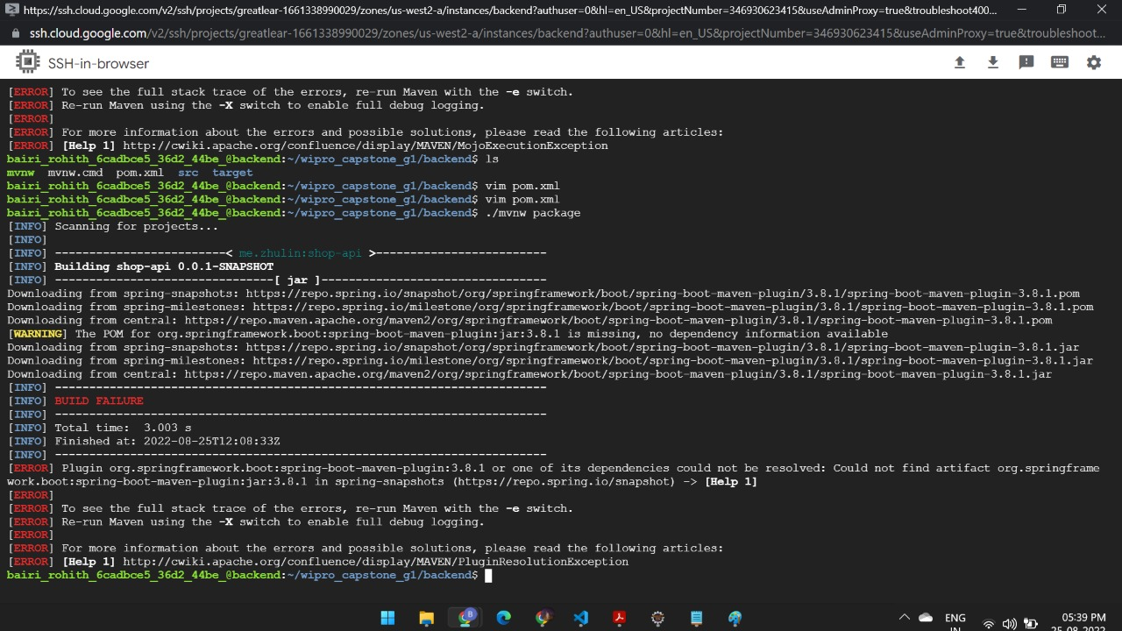

Slide 25
CONCLUSION
This E-Commerce Website helps customers to buy products through online without any physical interaction with the sellers due to covid-19.
This project helped us in gaining valuable information and practical knowledge on several topics like designing web pages using html & CSS, usage of responsive templates, designing of android applications, and management of database using MySQL.
The purpose of this project was to develop a web application and an android application for purchasing items from a shop.

Slide 26


